Slide 1
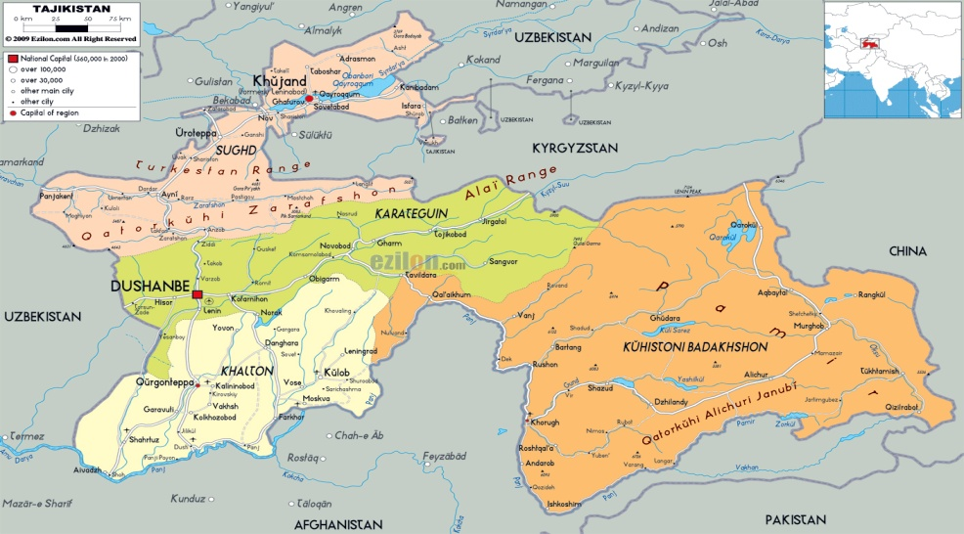
Tajik migrants and access to HIV and TB services IOM‘s experience in addressing migrants‘ health needs
Rukhshona Kurbonova, MD
International Organization for Migration - The UN Migration Agency in Tajikistan
AIDS 2018 Conference, Amsterdam (Netherlands), 26 July 2018

Slide 2
Content
Why migrants?
IOM’s approach to address migrants’ health needs
The gaps
Bridging the gaps

Slide 3
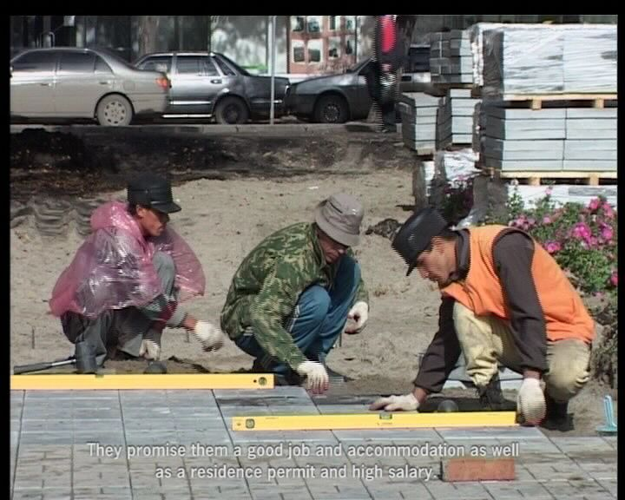
Why migrants? (1)
The working age population in Russia in 2012-2022 will be reduced by 8-11 million people
-> This demographic process will shape the growing demand for migrant labor
Labor migrant workers in 2013 produced a GDP of 1.4 trillion rubles (in constant prices for 2008), accounting for 3.12% of Russia's GDP
Remittances contributed to dropping the poverty level in Tajikistan in the period 2000-2016 from 81% to 30,3%.
Sources:
Рязанцев С.В. «Вклад трудовой миграции в экономику России: методы оценки и результаты». Гуманитарные науки. Вестник Финансового Университета №2 (22)/2016
Brownbridge M. and S.Canagariajah. Remittances and the Macroeconomic Impact of the Global Economic Crisis in the Kyrgyz Republic and Tajikistan. The China and Eurasia Forum Quarterly, Winter 2010
UNDP Tajikistan, Analytical Brief, April 2017, available at http://www.untj.org/jambi-project/images/Extreme-Poverty_ENG.pdf
Notes:
Трудящиеся мигранты вносят большой вклад в развитие как стран приема, так и страны происхождения
Инклюзивная политика и инвестирование в здоровье мигрантов – не альтруизм, это долгосрочное вложение в экономическое развитие и общественное здравоохранение

Slide 4
Why migrants? (2)
The proportion of migrants among new HIV cases in 2013 was 12.3%, in 2017 it increased to 14.6%, and in the first 3 months of 2018 it was 18,1%
“The effect of healthy migrants" is observed for the first 2 years as a result of self-selection of healthier people who decided to go to work
"The effect of exhausted migrants": 34% of migrants living in the receiving country more than 5 years noted that health worsened
According to the Ministry of Health of the Republic of Tajikistan, in 2011, 13,5% of officially registered new TB cases were returned migrants, in 2016 the proportion of migrants with TB increased to 17.6%
Migrants start treatment later than non-migrants
Source:
О.А. Кислицина. Институт социально-экономических проблем народонаселения РАН, Москва. «Различия в состоянии здоровья мигрантов и коренного населения в России и других странах Европейского региона». Социальные аспекты здоровья населения. Электронный журнал. 08.07.2013. http://vestnik/mednet.ru/index2.php?option=com_content&task=view&id=478&pop=1&page=0&Itemid=30
Republican Center for AIDS Prevention and Control of the Republic of Tajikistan
Notes:
Трудящиеся мигранты вносят большой вклад в развитие как стран приема, так и страны происхождения
Инклюзивная политика и инвестирование в здоровье мигрантов – не альтруизм, это долгосрочное вложение в экономическое развитие и общественное здравоохранение

Slide 5
HIV among returned Tajik migrant workers (2)
HIV prevalence among migrant workers (2013)
Proportion of migrants among PLHIV (2018)
Source: data shared by the Republican Center for AIDS Prevention and Control

Slide 6
ТB and HIV among migrants in the Russian Federation (2013)
 | Citizens of the RF per 100 000 | Migrants in the RF per 100 000
TB detection | 61.6 | 163.2
HIV detection | 315.1 | 107.5
Detection of new TB cases among migrants is 2.65 times higher than among the native population of the Russian Federation
Detection of HIV among migrants is 2.9 times less than among the native population of the Russian Federation
Source: http://www.mednet.ru/images/stories/files/CMT/migranty.pdf

Slide 7
HIV and ТB among migrants in the Russian Federation
Data of the Federal monitoring service on consumers rights and well-being protection (Rospotrebnadzor)
Migration in the Russian Federation | 10-15 million annually
Covered by health assessment in the period 2007 – 8 months 2015 | 1-1.8 million annually, 11 million in total
Detected with infectious diseases | 69.951

Slide 8
Undesirable stay of migrants in the Russian Federation due to infectious diseases
Reasons of decisions on undesirable stay of migrants from different countries in the Russian Federation as a result of health assessments in 2011-2015 (n = 13,594)
Approximately 70 per cent of notifications mailed to migrants were returned to Rospotrebnadzor due to the unavailability of addressee
-> these 70% did not receive treatment for their disease
Source: Federal Service on Monitoring of Consumers Rights and Wellbeing (Rospotrebnadzor),«Cross-border control and treatment of TB among labor migrant workers and members of their families from Central Asian countries in Russian Federation», presentation conducted during regional working meeting on cross-border control, prevention and treatment of TB among migrant workers and members of their families from Central Asia, Dushanbe, 29-30 September 2015.

Slide 9
Health vulnerabilities of Tajik migrants
Various factors lead to vulnerability of migrant workers:
Sources:
V.A. Iontsev, I.V.Ivakhnyuk, “The Role of International Labour Migration for the Economic Development of Russia”, Analytical Report. CARIM-East RR 2012/28, 2012 . Robert Schuman Centre for Advanced Studies, San Domenico di Fiesole(FI):European University Institute. Available from http://www.carim-east.eu/media/CARIM-East_RR-2012-04.pdf
C.Gilpin, P. Colombani, S, Hasanova, U. Sirodjiddinova, “Exploring TB-Related Knowledge, Attitude, Behavior, and Practice among Migrant Workers in Tajikistan”, Tuberculosis Research and Treatment, Volume 2011, Article ID 548617, doi:10.1155/2011/548617
Weine, S., et al. Trauma Exposure, PTSD, and HIV Sexual Risk behaviors among Labour Migrants from Tajikistan. AIDS behave.2012 August; 16 (6): 1659-1669. doi: 10.1007/s10461-011-0122-9
L.Jing, S.Weine, M.Bahromov,A.,Golobof.,”Does Powerlessnes Explain Elevated HIV Risk Among Tajik Labour Migrants? En Ethnographic Study”,J.HIV AIDS Soc Serv. 2012;11(2):102-124
R.Aye,K.Wyss,H.Abdualimova,S.Sadaliev,”Patient’s site of first access to health system influences length of delay for tuberculosis treatment in Tajikistan”.BMS Health services research 201010:10.
R. Ayé, K. Wyss, H. Abdualimova, and S. Saidaliev, "Factors determining household expenditure for tuberculosis and coping strategies in Tajikistan." Tropical Medicine & International Health 16, no. 3 (2011): 307-313, p.310
O.Demihova, O. Nechaeva, “Issues of the migrants’ access to early detection, diagnostic, prevention and treatment of the tuberculosis and tuberculosis combined with HIV”, Analytical review. Available at http://www.mednet.ru/images/stories/files/CMT/migranty.pdf
E. King, K.Maksymenko, Y.Almodovar-Diaz,S.Johnson, “If she is a good woman…”and “to be a real man…:gender,risk and access to HIV services among key populations in Tajikistan”. Culture,Health&Sexualality, 2015 , http://dx.doi.org/10.1080/13691058.2015.1089603
Undocumented status abroad, poor living and working conditions (1, 2)
Sexual risk behavior associated with higher indirect trauma exposure (3)
High cost and fear of deportation as main barriers to access health care in the countries of destination (2, 7)
Stigma and discrimination towards people with HIV and TB (7, 8)
Language barrier among migrants (7)
Gender aspect: male migrants are less likely to contact doctors, they approach them only in life-threatening situations at end stages of disease progression. Since migrant workers are the main “breadwinners” of their families, they have poor health-seeking behaviors due to fear of retrenchment, despite disease progression (3, 4)

Slide 10
HIV –related knowledge, attitude and practice of migrants in the Russian Federation
60% of migrants do not worry about the risk to be infected by HIV
Every 10th migrant who engaged in risky sexual behavior did not use condoms
More than half of migrants did not pass HIV test
Every 10th migrant who passed HIV test did not know the result of the test
Only half of the migrants working in Russia have a medical certificate of a health assessment
25-30% of migrants with medical certificates did not pass the health assessment
Migrants rarely approach health services in the receiving countries (only 7% in Kazakhstan and 17% in Russia). The majority delay the visit to the health provider and prefer treatment at home.
Source:
International Federation of Red Cross and Red Crescent Societies, Russian Public Organisation “Russian Red Cross”, Lilly Partnership on MDR-TB, “Awareness of migrants on TB and HIV”, Moscow, January 2015
B. Sergeev, et al., “Labour migrants in St. Petersburg: disease awareness, behavioral risks and counseling by health professionals in building up prevention against TB, HIV and associated infections”, J.Public Health, DOI 10.1007/s10389-015-0669-4, April 2015
Notes:
International Federation of Red Cross and Red Crescent Societies, Russian Public Organisation “Russian Red Cross”, Lilly Partnership on MDR-TB, “Awareness of migrants on TB and HIV”, Moscow, January 2015
B. Sergeev, et al., “Labour migrants in St. Petersburg: disease awareness, behavioral risks and counseling by health professionals in building up prevention against TB, HIV and associated infections”, J.Public Health, DOI 10.1007/s10389-015-0669-4, April 2015

Slide 11
IOM’s approach to address migrants’ health needs
Monitoring migrant health
Research and information dissemination
Policy and legal framework
Advocacy for policy development to protect migrants health
Partnership, networks, multi-country frameworks
Strengthening inter-country coordination and cross border partnership
Migrant sensitive health system
Improving migrant’s access to healthcare and capacity building
Notes:
MHU in Tajikistan work within the four main pillars (following IOM concept): monitoring of the migrants health, policy and legal framework, migrant sensitive health system; partnership/networks/multicountry framework

Slide 12
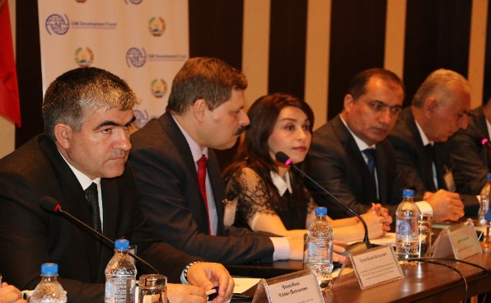
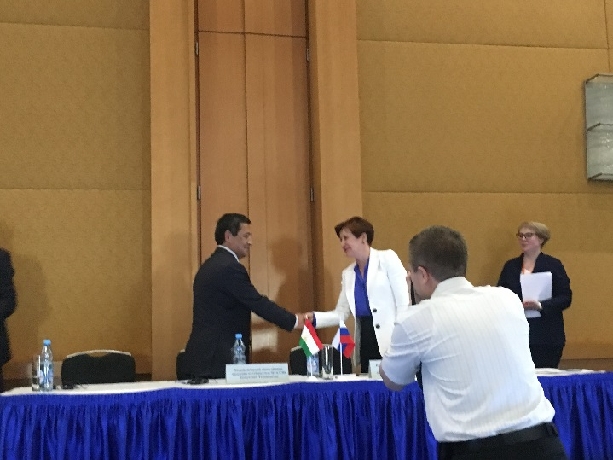
Policy and legal framework
IOM actively supported the migration health working group within the framework of the Eurasian Economic Community (EurAsEC). In the period 2008-2011 eight events including international trips of Tajik health authorities have been arranged
In 2017, IOM facilitated establishing a bilateral Technical Working Group on cross border TB control and care between Tajikistan and the Russian Federation
On 1 June 2018 the MoU on cooperation between the Tajik and Russian NTP (Research Institute on phtysiopulmonology and infection diseases of the Ministry of Health of the Russian Federation) was signed
Notes:
Within EurAsEC migration health working group initiated and chaired by the Tajik Ministry of health developed a number of the documents on monitoring of the migrants health including health assessment of the migrants in the countries of origin, joint monitoring of the assigned clnics responsible for the migrants health assessment, template of he health certificate that should be acknowledged by the countries of EurAsEC. The documents were signed on the level of the Ministers of health but on the stage of the signing by the Presidents of the countries EurAsEC was terminated (On 10 October 2014, an agreement on the termination of the Eurasian Economic Community was signed in Minsk after a session of the Interstate Council of the EurAsEC). The Eurasian Economic Community was terminated from 1 January 2015 in connection with the launch of the Eurasion Economic Union. While the Eurasian Economic Union effectively replaces the community, membership negotiations with Tajikistan are still ongoing. All other EAEC members have joined the new union.

Slide 13
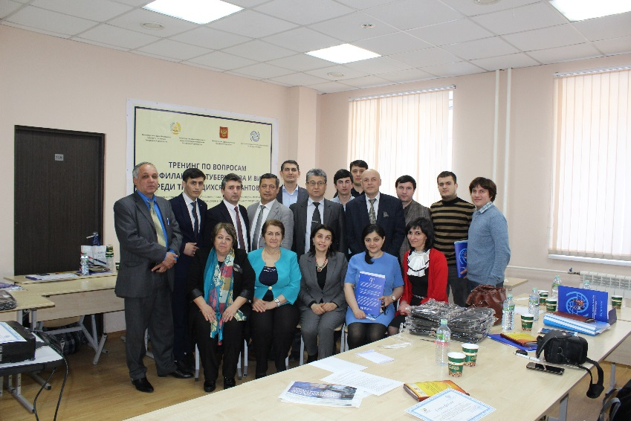
Partnership, networks & multicountry frameworks
Multisectoral approach
Partnership with civil society organizations:
- IOM built capacity of the local NGO network on promoting migrants health, particularly HIV prevention
IOM built capacity of the Tajik Diaspora
Cooperation with Russian HIV service NGOs
Cooperation with academia (Research Network on TB for Eastern Europe and Central Asia)

Slide 14
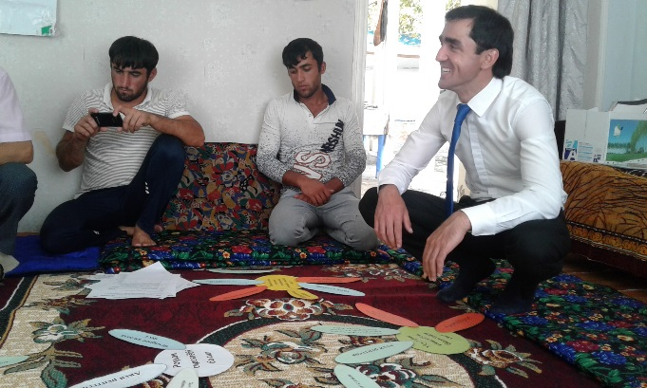
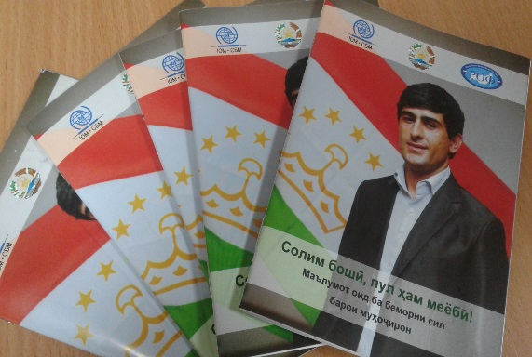
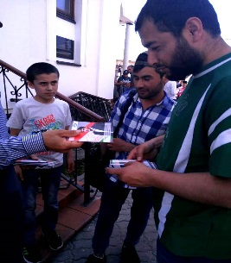
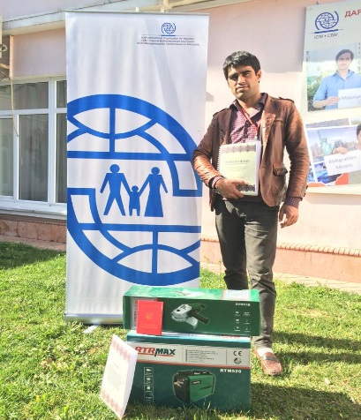
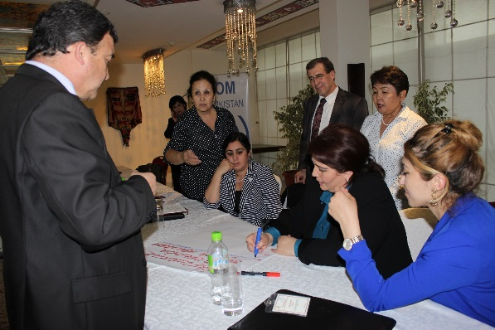
Migrant-sensitive health systems
Peer education
Diaspora engagement
IEC in native languages
Promoting cultural competence of the health professionals
Providing psychosocial support
Providing opportunities for income generation for livelihood

Slide 15
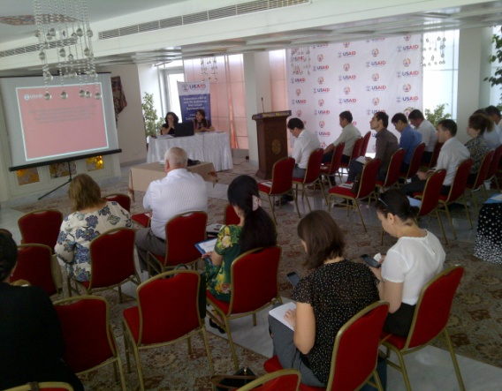
Research and information dissemination
Since 2005 IOM Tajikistan conducted studies among migrants on knowledge, attitude and practice related to sexually transmitted infections, HIV and TB (supported by Global Fund, WB/DFID)
Study among foreign citizens – migrant workers in Tajikistan conducted in 2011-2013 (IDF)
Study on mobility of health workers from Tajikistan conducted in 2012-2013 (IDF)
Assessment on access of migrants and their families to comprehensive TB, MDR TB, TB/HIV services in Tajikistan conducted in 2016 (USAID TB Control Program)

Slide 16
The gaps
Deportation policy of PLHIV in the Russian Federation > Fear of deportation significantly influences diagnostic delay
Lack of referral mechanisms between countries, limited data exchange
Insufficient integration between primary healthcare, HIV and TB services
Lack of the regulation mechanisms on TB prevention and treatment among foreign citizens in the countries of destination
Lack of the reliable data and research on HIV and TB among migrants
Lack of the utilizing the platform of the Commonwealth of Independent States (CIS) for the sustainable regional, cross border interventions
Dependence of national TB and HIV programmes on external funding
Lack of social support of returned migrants with HIV, TB and MDR TB
Source: Analysis of public expenses for tuberculosis control in the Republic of Tajikistan in 2013

Slide 17
Bridging the gap
Promoting cross border multisectoral activities for HIV and TB prevention, control and care among migrants
Advocating against stigma and discrimination of PLHIV
Facilitating dialogue between countries of origin and destination
Engaging Diaspora to improve migrant’s access to HIV and TB services
Technical support for extending pre departure health assessment among migrants
Promoting research on migration and health

Slide 18
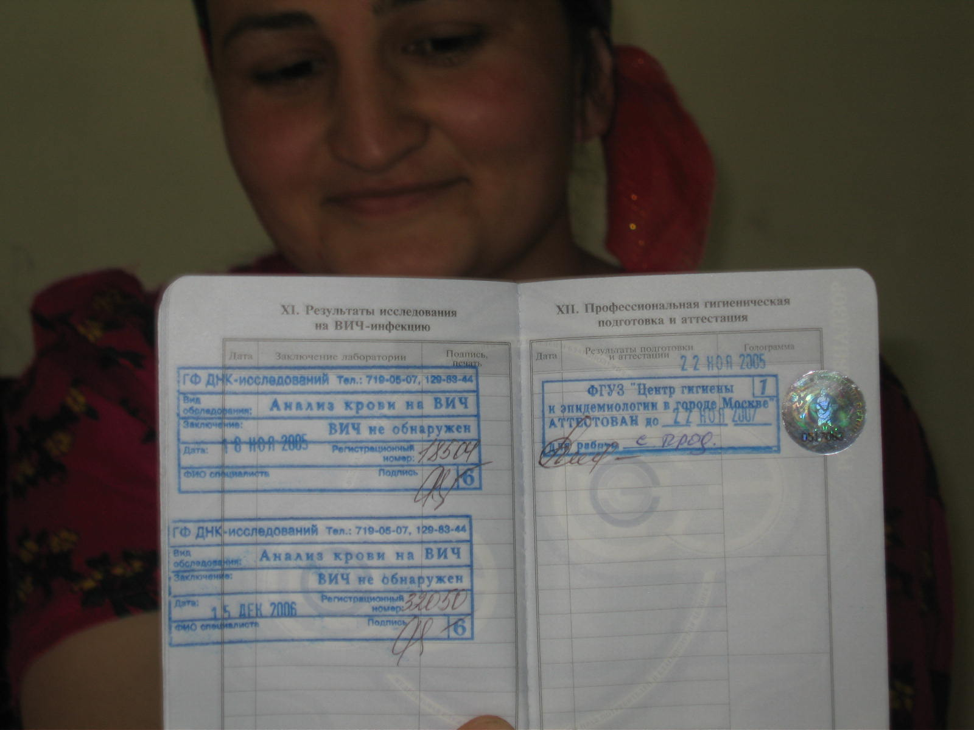
Thank you for your attention!

